Slide 1
A Novel Evaluation Methodology for Assessing Off-Policy Learning Methods in Contextual Bandits
Negar Hassanpour and Russ Greiner Department of Computing Science University of Alberta

Slide 2
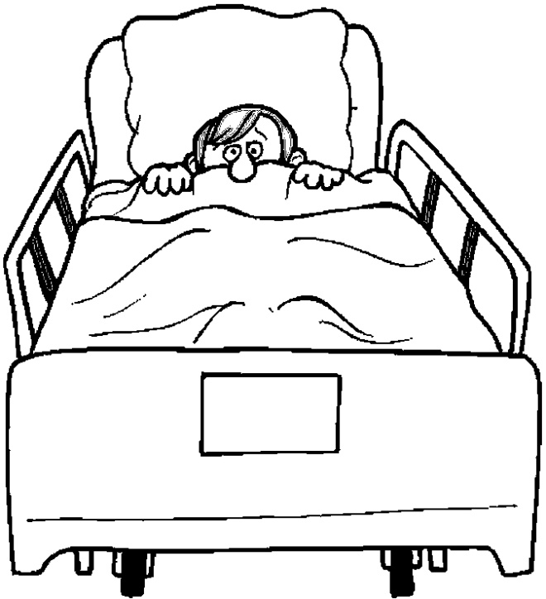
Problem Statement
ID | X |  |  | T | Y⁰ | Y¹
 | Gender | Age | BMI
Mr. Smith | Male | 35 | 20 | 1 | 15
ID | X |  |  | T
 | Gender | Age | BMI
Mr. Smith | Male | 35 | 20 | 0
ID | X
 | Gender | Age | BMI
Mr. Smith | Male | 35 | 20
ID | X |  |  | T | Y¹ | Y⁰
 | Gender | Age | BMI
Mr. Smith | Male | 35 | 20 | 1 | 15
Mr. Green | Male | 22 | 32 | 0 | 22
Ms. Jones | Female | 20 | 23 | 1 |  | 31
. . .
T=0
T=0
T=1
Notes:
Great nitro! After setting T=0, have the T=1 blue pill fade – so emphasize only

Slide 3
Problem Statement
ID | X |  |  | T | Y⁰ | Y¹
 | Gender | Age | BMI
Mr. Smith | Male | 35 | 20 | 1 | 15
ID | X |  |  | T
 | Gender | Age | BMI
Mr. Smith | Male | 35 | 20 | 0
ID | X
 | Gender | Age | BMI
Mr. Smith | Male | 35 | 20
ID | X |  |  | T | Y¹ | Y⁰
 | Gender | Age | BMI
Mr. Smith | Male | 35 | 20 | 1 | 15
Mr. Green | Male | 22 | 32 | 0 | 22
Ms. Jones | Female | 20 | 23 | 1 |  | 31
. . .
25
29
18
Goal:
Find counterfactual outcomes
to calculate the individual treatment effects (ITE) … in order to facilitate finding the best personalized treatment option for a novel patient
Challenge:
In real-world datasets, the counterfactual outcomes are not observable
i.e., no time-machine invented yet!
Notes:
Great nitro! After setting T=0, have the T=1 blue pill fade – so emphasize only

Slide 4
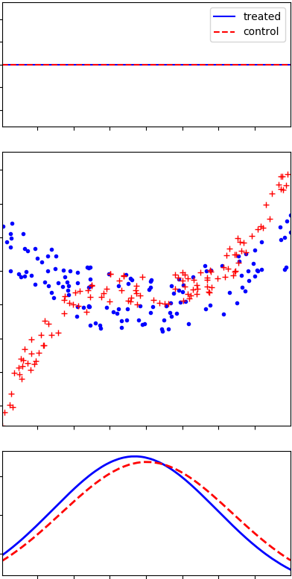
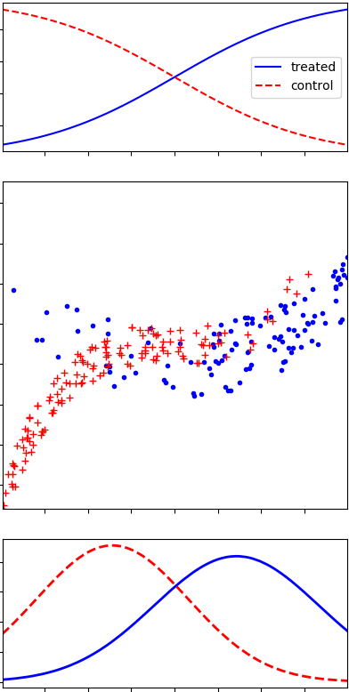
Types of Real-world Datasets
Randomized Controlled Trial
Observational Study
Need Realistic
Synthetic Datasets [Counterfactuals Available]
t = 0
t = 1
t = 0
t = 1
outcome
outcome
x
x
Same dist’n of X for Red, and Blue
Different dist’n of X for Red, and Blue

Slide 5
Outline
Motivation
Existing Approach
[Beygelzimer and Langford, 2009]
[Swaminathan and Joachims, 2015a]
Proposed Approach
Experiments
Conclusions

Slide 6
Pipeline
multi-binary-label Supervised Dataset
X |  |  | T*
x₁₁ | x₁₂ | x₁₃ | 1 | 0 | 1
x₂₁ | x₂₂ | x₂₃ | 0 | 0 | 1
x₃₁ | x₃₂ | x₃₃ | 0 | 0 | 1
. . .
T
1 | 0 | 1
0 | 1 | 0
1 | 1 | 0
. . .
Logging Policy h₀(t|x)
Sample new T
5%
Jaccard Score
X |  |  | T |  |  | Y
x₁₁ | x₁₂ | x₁₃ | 1 | 0 | 1 | 3
x₂₁ | x₂₂ | x₂₃ | 0 | 1 | 0 | 1
x₃₁ | x₃₂ | x₃₃ | 1 | 1 | 0 | 0
. . .
Contextual Bandit Dataset

Slide 7
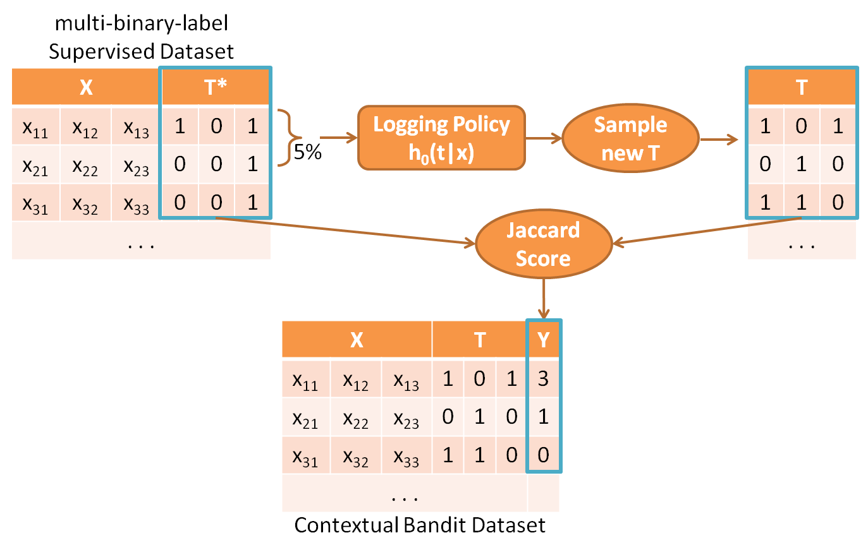
Shortcomings
How to map
a binary multi-label {0,1}^{k} to a medical treatment?
(?? drug interactions ??)
Using the Jaccard score to define outcomes
→ equal importance to various treatment options
Assumes known underlying mechanism of treatment selection (e.g., in ad-placement);
i.e., h₀(t|x) value is given as part of the dataset (input)

Slide 8
Outline
Motivation
Existing Approach
Proposed Approach
Experiments
Conclusions

Slide 9
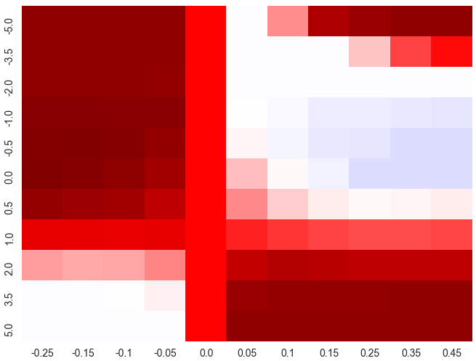
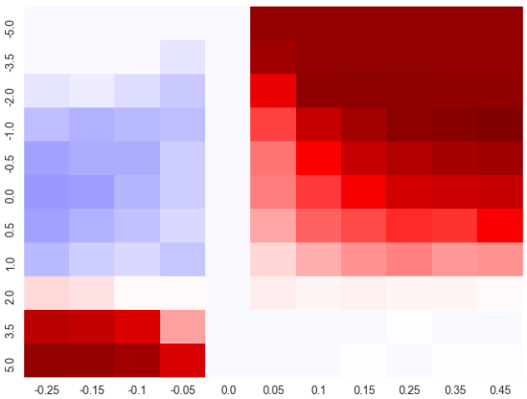
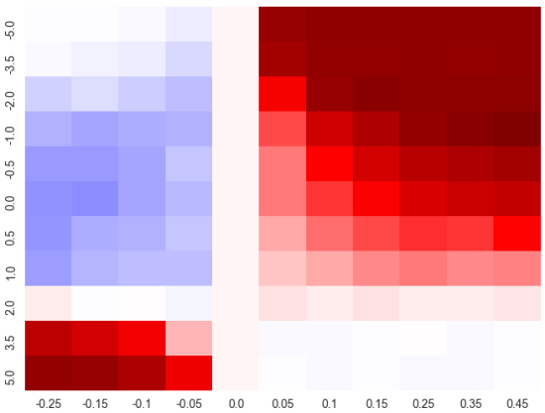
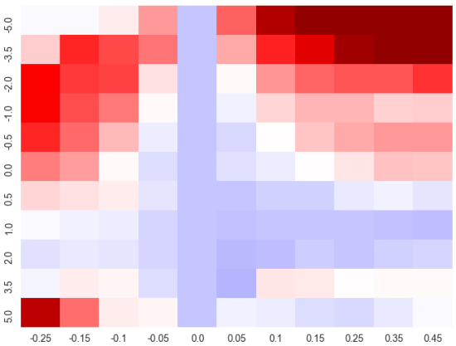
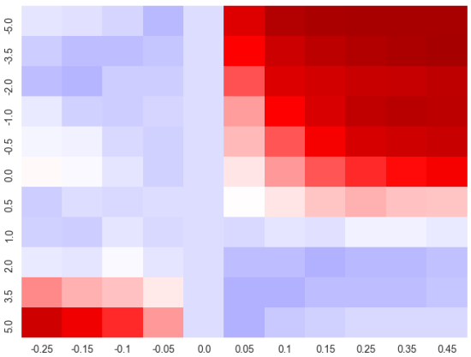
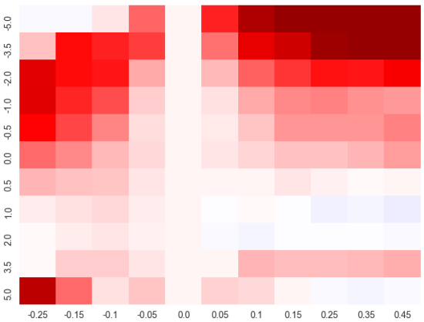
Pipeline
Original RCT Dataset (RCT*)
ID | X |  |  | T | Y⁰ | Y¹
 | Sex | Age | BMI
Mr. Smith | M | 35 | 20 | 0 | 15
Mr. Green | M | 22 | 32 | 0 | 22
Ms. Jones | F | 20 | 23 | 1 |  | 31
ID | X |  |  | Y⁰ | Y¹
 | Sex | Age | BMI
Mr. Smith | M | 35 | 20 | 15 | 25
Mr. Green | M | 22 | 32 | 22 | 29
Ms. Jones | F | 20 | 23 | 18 | 31
Completion
(match ATE and R²)
ID | X |  |  | T | Y⁰ | Y¹
 | Sex | Age | BMI
Mr. Smith | M | 35 | 20 | 1 |  | 25
Mr. Green | M | 22 | 32 | 0 | 22
Ms. Jones | F | 20 | 23 | 0 | 18
ID | X |  |  | T | Y⁰ | Y¹
 | Sex | Age | BMI
Mr. Smith | M | 35 | 20 | 0 | 15
Mr. Green | M | 22 | 32 | 1 |  | 29
Ms. Jones | F | 20 | 23 | 0 | 18
ID | X |  |  | T | Y⁰ | Y¹
 | Sex | Age | BMI
Mr. Smith | M | 35 | 20 | 1 |  | 25
Mr. Green | M | 22 | 32 | 1 |  | 29
Ms. Jones | F | 20 | 23 | 0 | 18
α
Synthesize bandit datasets
α
Synthesize Bandit dataset
β
β
Output Prediction
Evaluation
β
Logger
IPS-ERM
IPS-CRM
DR-ERM
SN-ERM
α

Slide 10
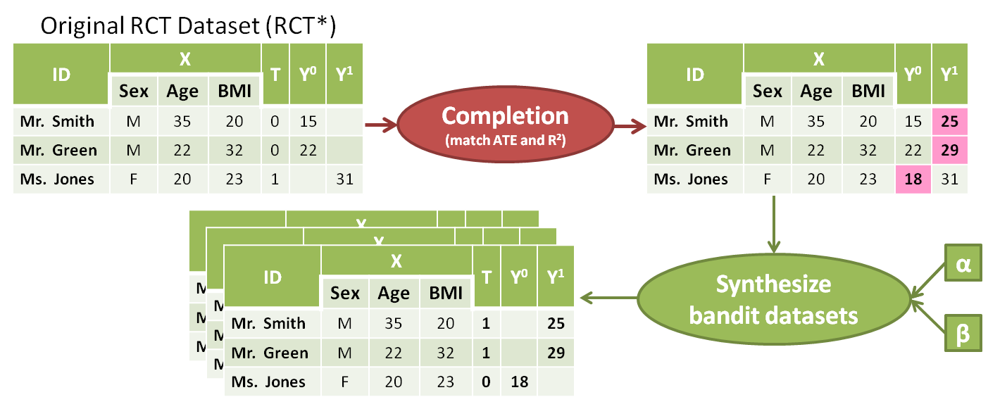
RCT*’s Characteristics
Goal: To generate synthetic bandit datasets as similar as possible to a real bandit dataset
Match: □ Average Treatment Effect
□ Coefficients of Determination

Slide 11
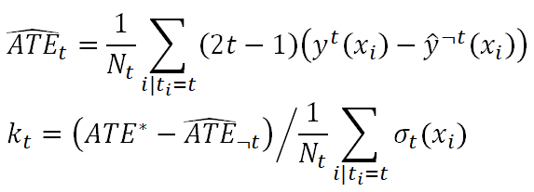
Derive Counterfactual Functions
Fit Gaussian Process to each treatment arm:
Set counterfactual functions to:
Find k_{t} and ε_{t} such that each new sampled RCT (i.e., synthetic) has ATE and R² similar to those of RCT*

Slide 12
RCT*
Synthetic RCT
Note that the y⁰ and y¹ dist’n for RCT* = Syn RCT

Slide 13
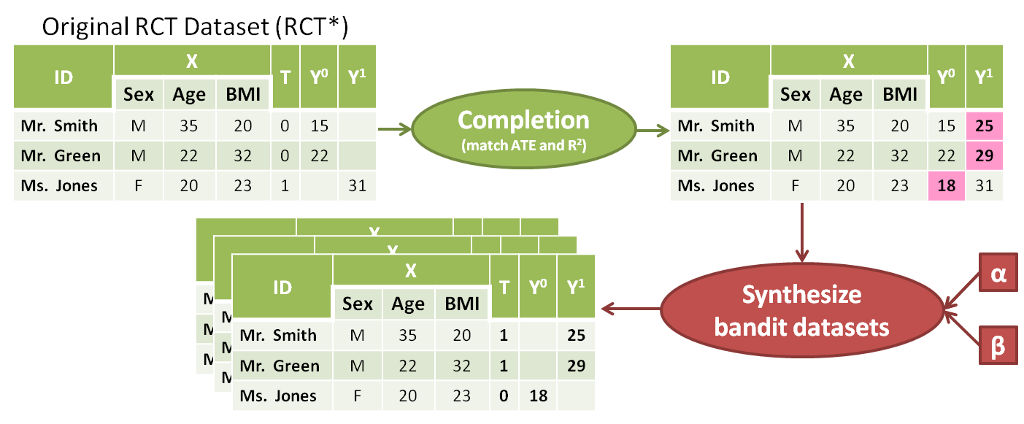
Induce Selection Bias
Logging policy h_{α,β}(t|x) is a sigmoid with α and β parameters; z=z(x) induces the sample selection bias.
z could be:
any covariate such as age, gender, etc.
First Principal Component (PC1)
…
Notes:
Removed: is function of x that

Slide 14
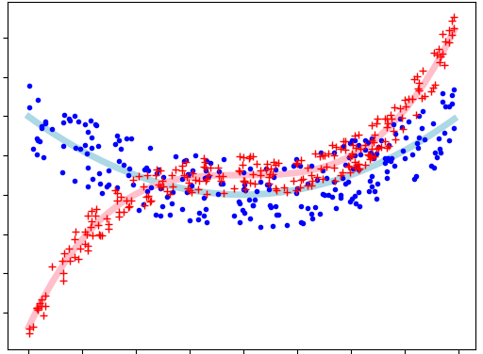
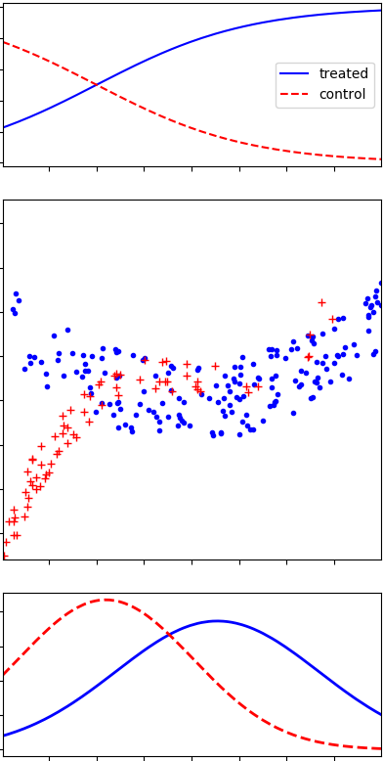
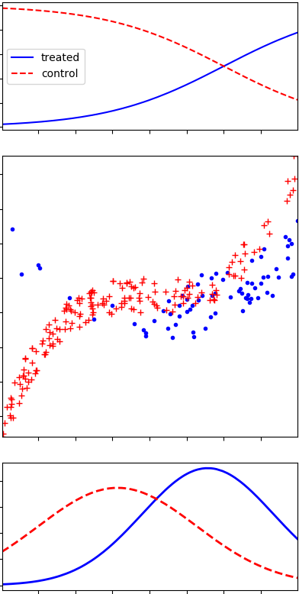
Effect of α and β on Selection Bias
α = 0
α = 1, β = 0
α = 1, β = 1
α = 1, β = -1

Slide 15
Outline
Motivation
Existing Approach
Proposed Approach
Experiments
Conclusions

Slide 16
RCT* Datasets
Acupuncture
benefit of acupuncture (in addition to standard care) for treating chronic headache disorders
18 features, 295 subjects
Hypericum
acute efficacy of St. John’s Wort in treatment of patients with major depression disorder
278 features, 161 subjects
Original RCT | Synthesized RCTs
ATE*= −6.15 | ATE = −6.17(0.76)
R²₀*= 0.68 | R²₀ = 0.60(0.05)
R²₁* = 0.33 | R²₁ = 0.36(0.07)
Original RCT | Synthesized RCTs
ATE*= −2.25 | ATE = −2.65(0.97)
R²₀* = 0.24 | R²₀ = 0.15(0.10)
R²₁* = 0.00 | R²₁ = 0.04(0.09)

Slide 17
Methods Evaluated
Off-policy learning methods in contextual bandits:
Outcome Prediction (OP)
Inverse Propensity Scoring (IPS)
Doubly Robust (DR) [Dudík et al., 2011]
Self-Normalized (SN) [Swaminathan and Joachims, 2015b]
Each uses an objective function defined by either:
Empirical Risk Minimization (ERM) principle OR
Counterfactual Risk Minimization (CRM) principle [Swaminathan and Joachims, 2015c]

Slide 18
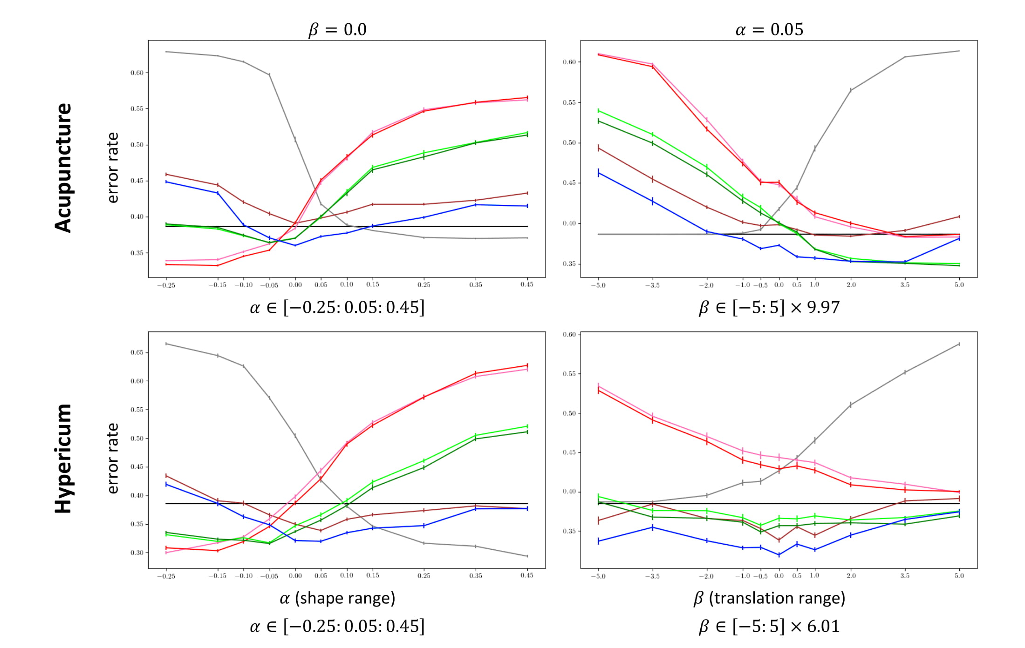
Results 1

Slide 19
Results 1

Slide 20
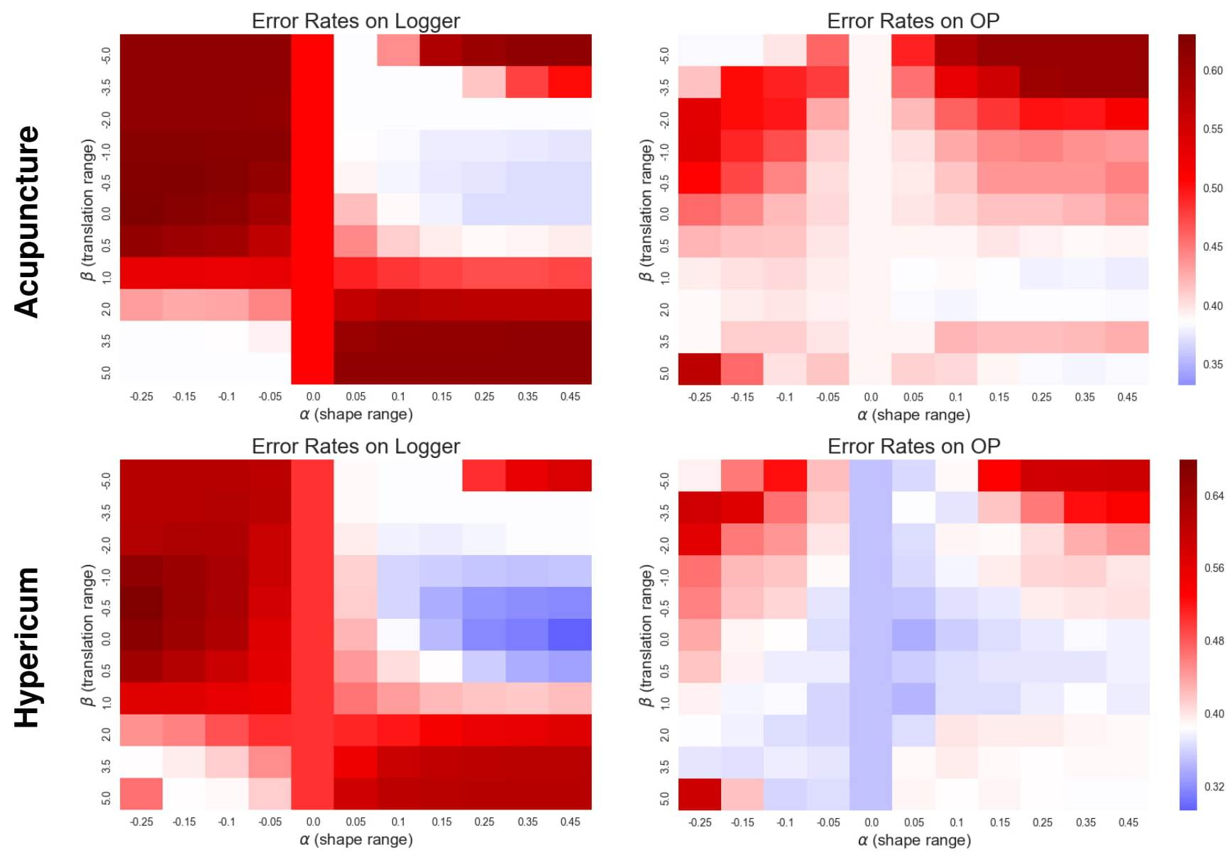
Results 2

Slide 21
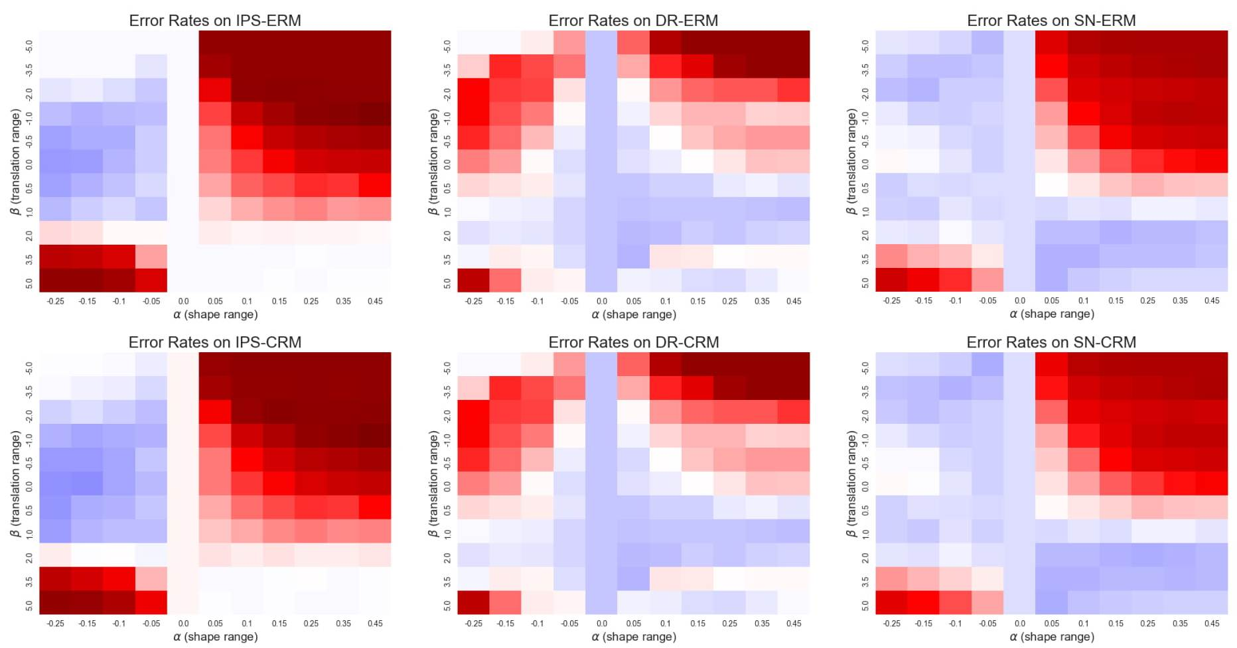
Acupuncture

Slide 22
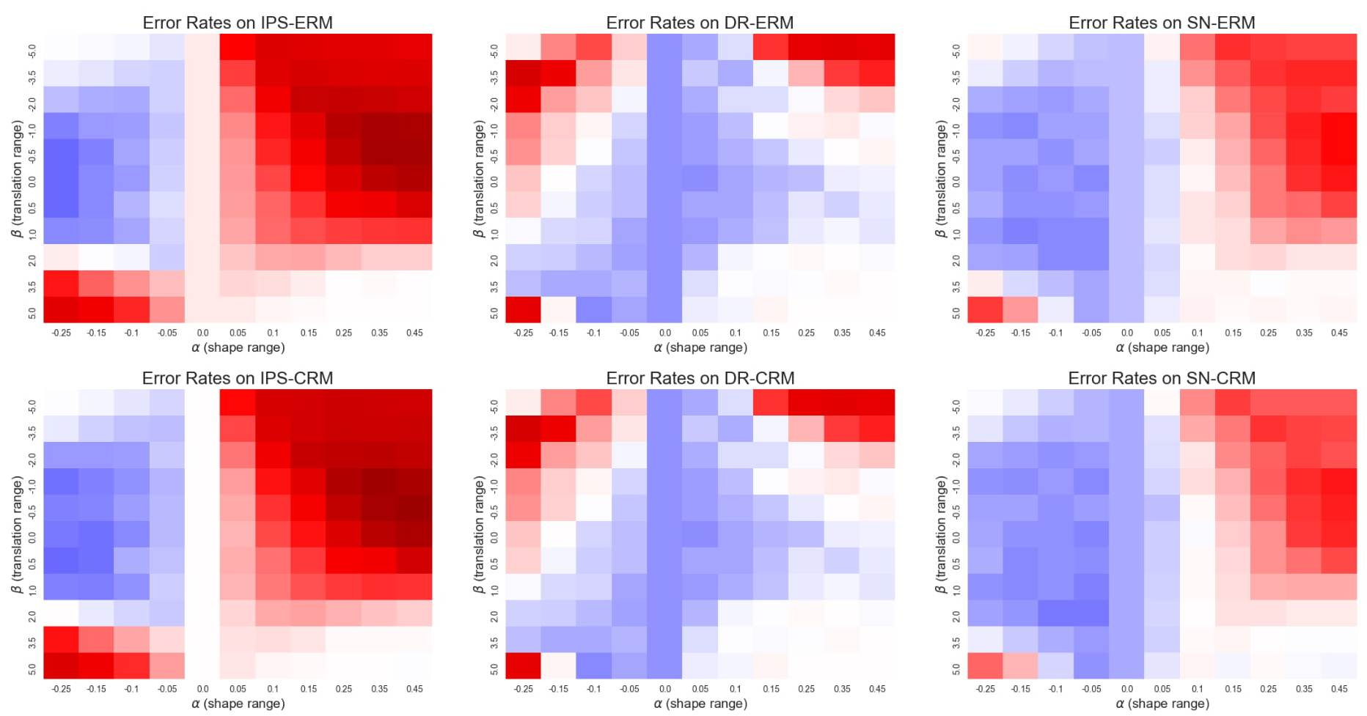
Hypericum

Slide 23
Outline
Motivation
Existing Approach
Proposed Approach
Experiments
Conclusions

Slide 24
Future Directions
Increase the pool size of possible treatments from |T| = 2 (i.e., t ∈ {0,1}).
Cover combining several medications or other medical interventions
Explore ways to extend this evaluation methodology for sequential observational studies.
Not trivial since the space of all possible decisions grows exponentially as we progress through the course of treatment
Create observational datasets that contain censored samples
i.e., when only a lower bound of the survival time of some of the patients is available.
→ Can use such datasets to develop and evaluate survival prediction methods that can handle sample selection bias

Slide 25
Conclusion
Our analyses show that
different off-policy learning methods exhibit different competencies
under different levels of sample selection bias
Our proposed evaluation framework enables us
to tease out these differences and
select the appropriate method for each real-world application
Such analysis was not possible with the existing evaluation methodology as it could not generate diverse observational datasets (in terms of selection bias)

Slide 26
Questions?
Negar Hassanpour
hassanpo@ualberta.ca

Slide 27
References
[Beygelzimer and Langford, 2009] Beygelzimer, A., Langford, J.: The offset tree for learning with partial labels. In: Proceedings of the 15th ACM SIGKDD, ACM (2009)
[Dudík et al., 2011] Dudík, M., Langford, J., Li, L.: Doubly robust policy evaluation and learning. International Conference on Machine Learning (2011)
[Swaminathan and Joachims, 2015a] Swaminathan, A., Joachims, T.: Batch learning from logged bandit feedback through counterfactual risk minimization. JMLR 16 (2015)
[Swaminathan and Joachims, 2015b] Swaminathan, A., Joachims, T.: The self-normalized estimator for counterfactual learning. In: Advances in Neural Information Processing Systems. (2015)
[Swaminathan and Joachims, 2015c] Swaminathan, A., Joachims, T.: Counterfactual risk minimization: Learning from logged bandit feedback. In: International Conference on Machine Learning. (2015)

